Slide 1
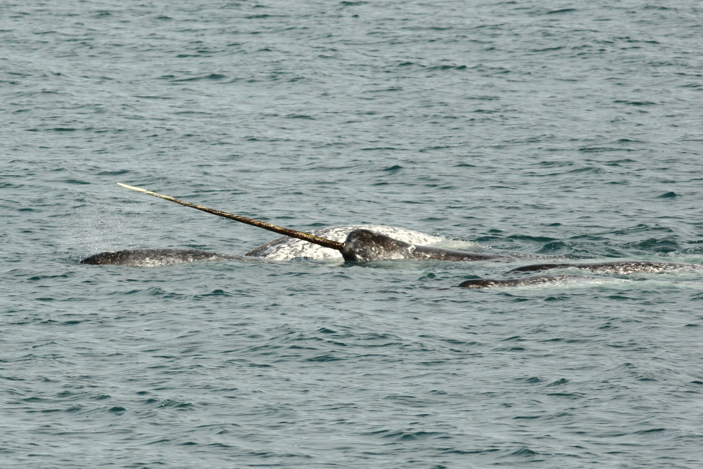

State-space models for animal movement
Marie Auger-Méthé
Canadian Research Chair Tier II in Statistical Ecology
Institute for the Oceans & Fisheries
Dept. of Statistics
University of British Columbia
Notes:
Thank you so much for the invitation and introduction, it’s really a big honor to present at ISEC. It’s also incredibly intimidating as I’m ecologist by training and I lreaned statistics by reading the books and papers from the people in this room. Today, I’ll do my best to give an overview of state-space models, which is a type of hierarchical model for time series that are used in many fields.
Throughout the talk, I’ll use animal movement examples, because they have been important in the development of state-space models, and because most of my work uses animal movement data.

Slide 2
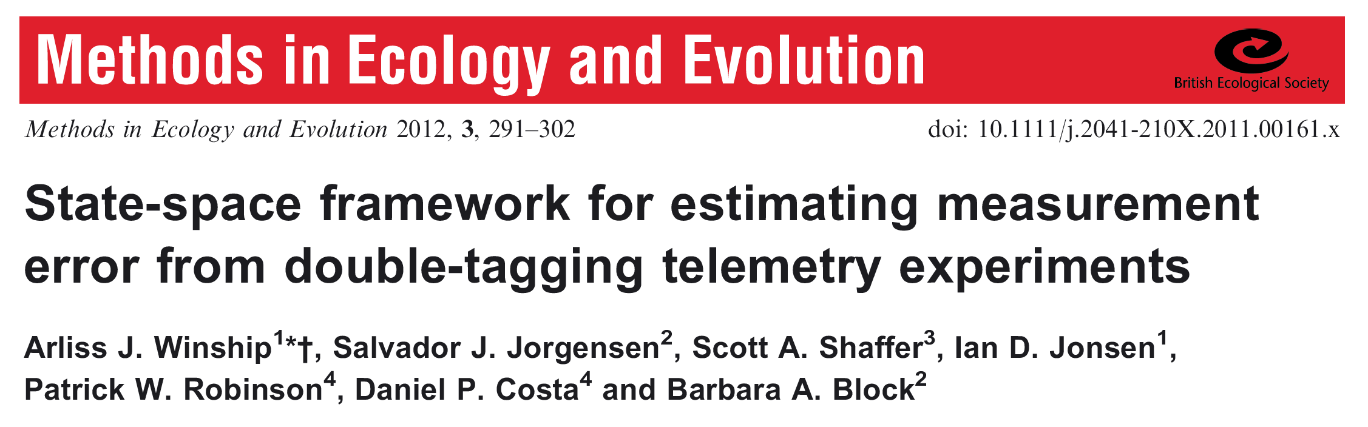
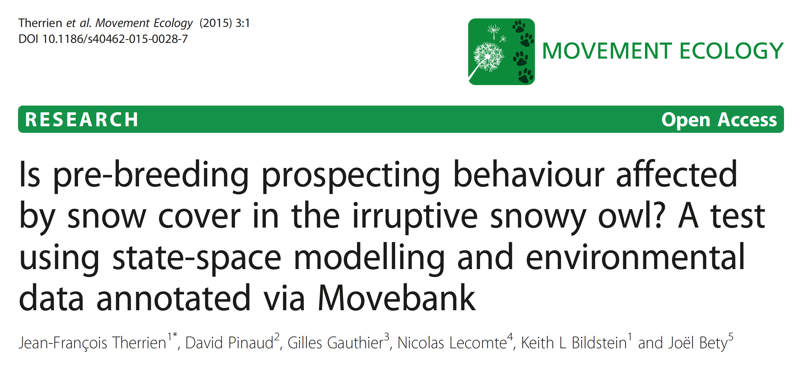
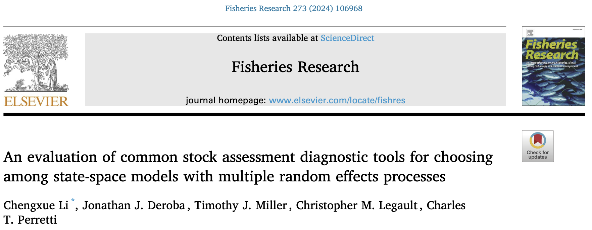
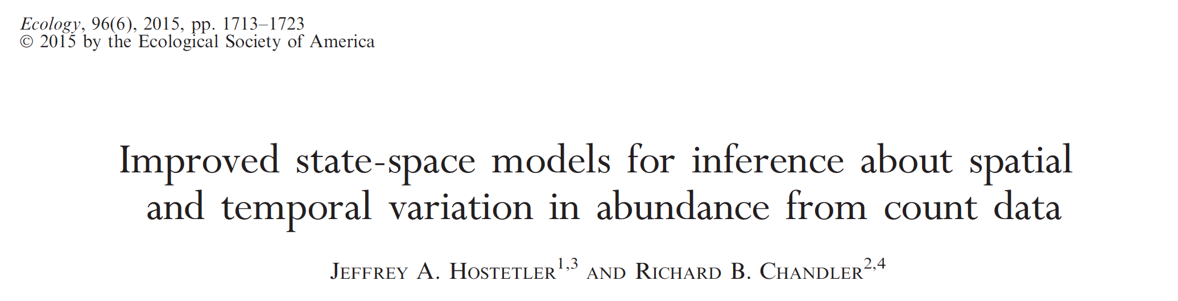
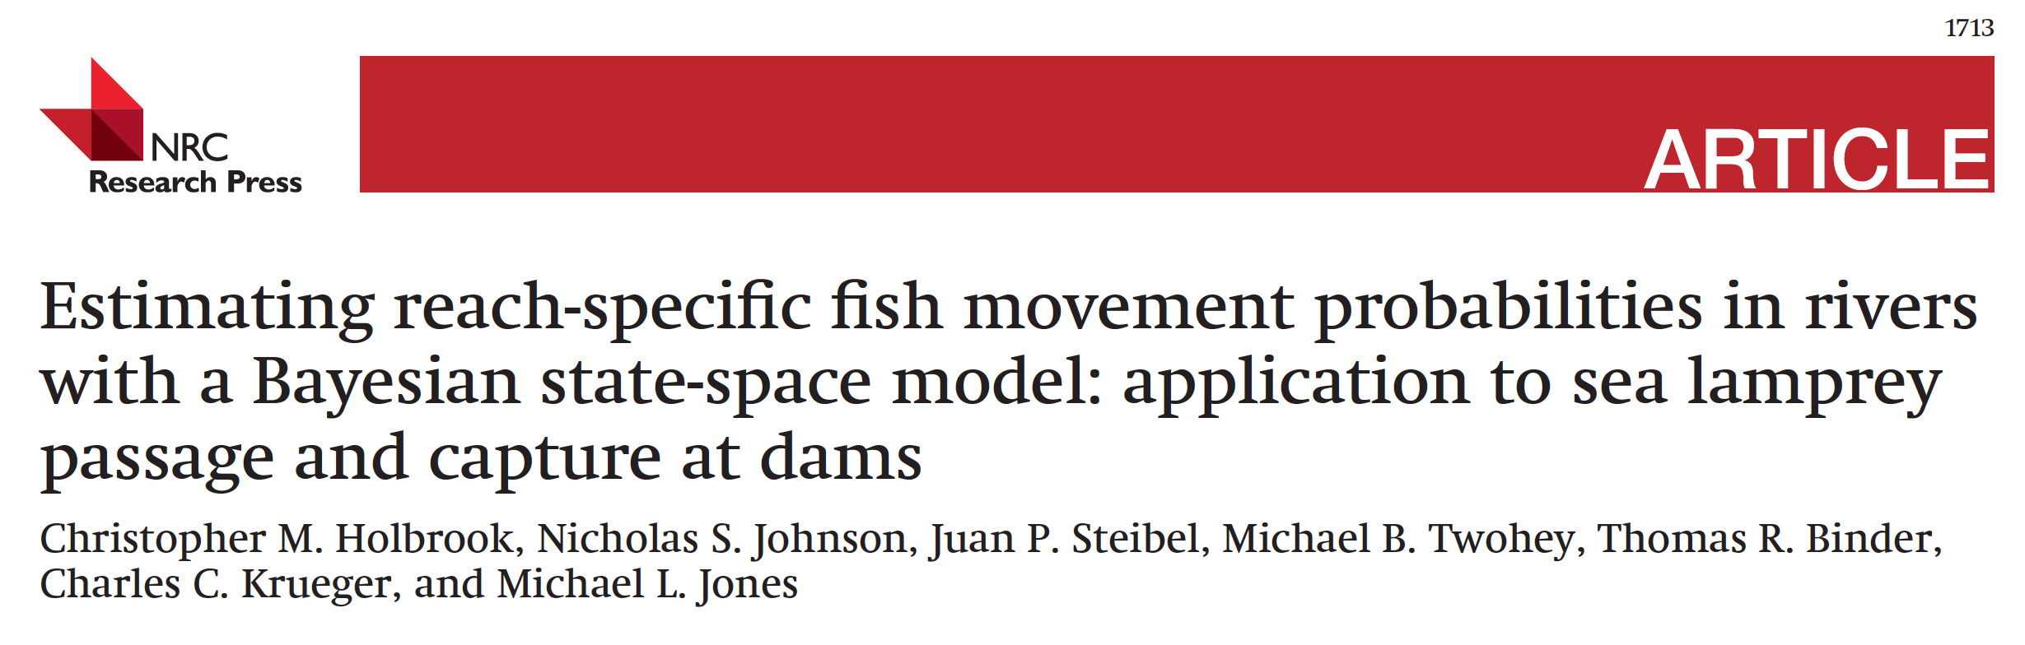
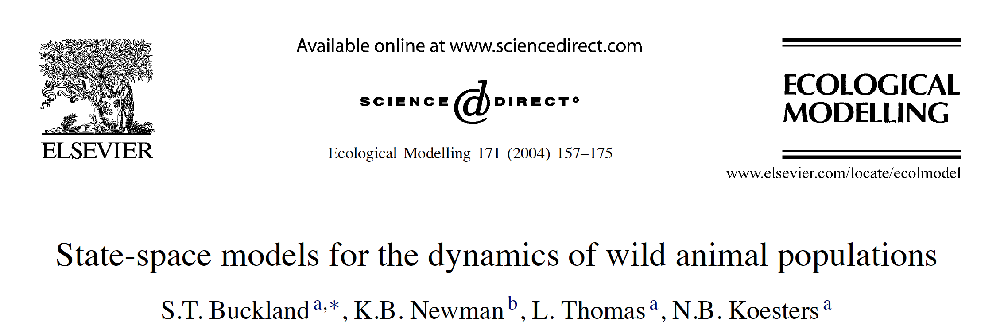
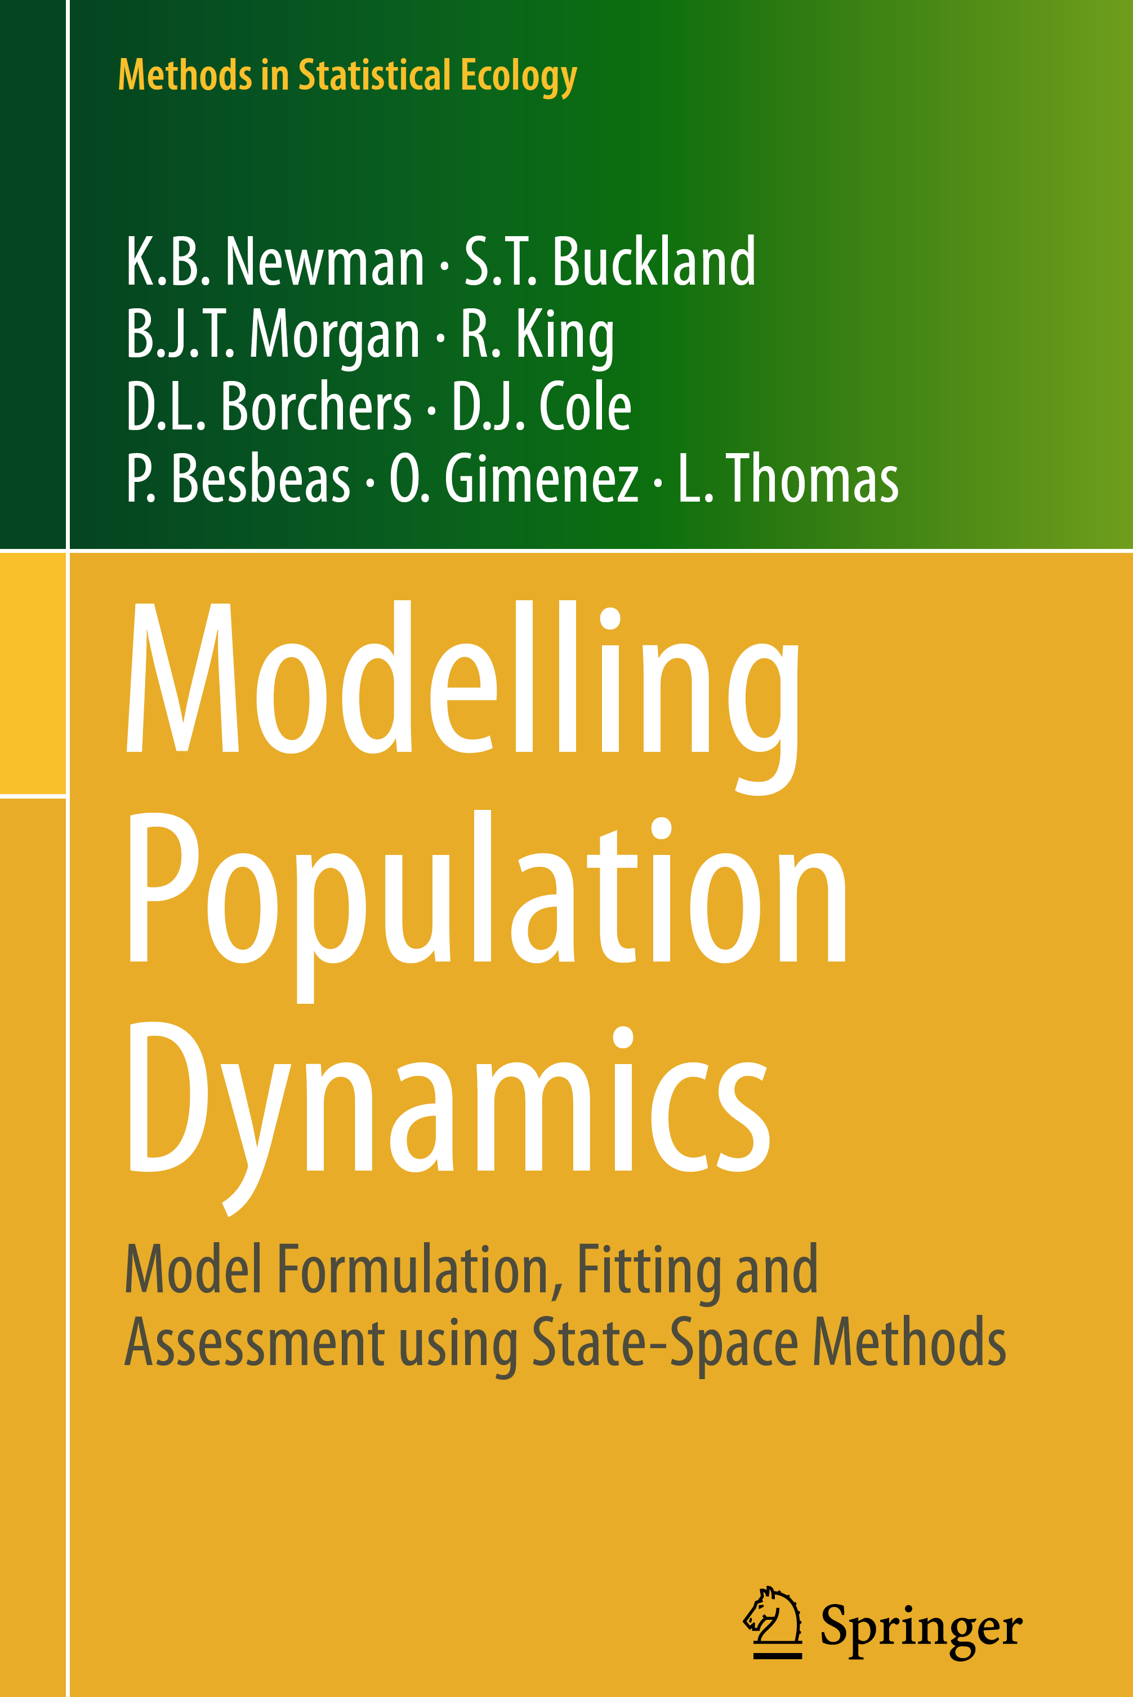
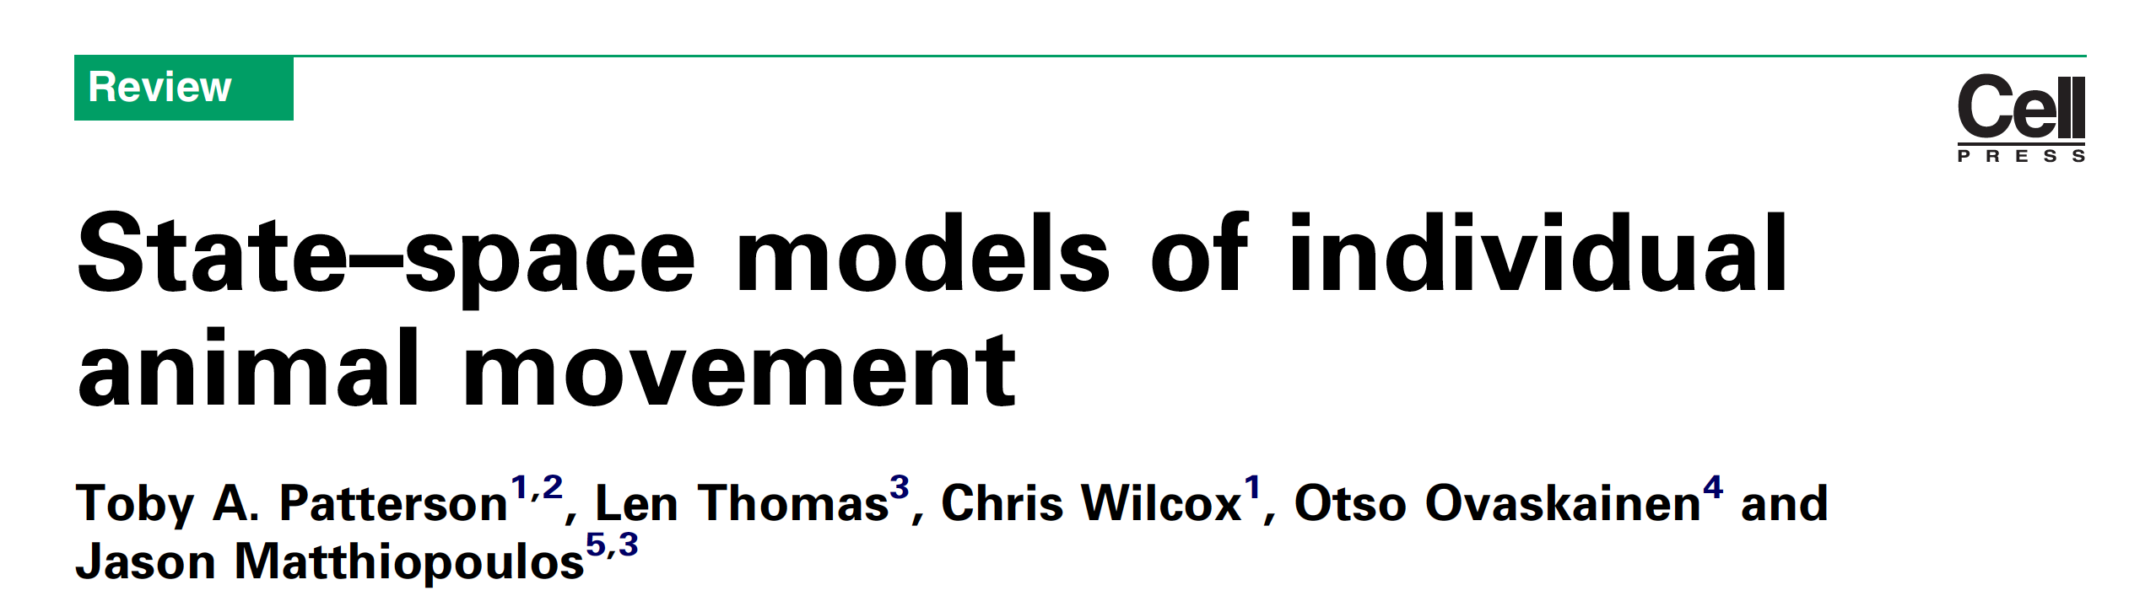
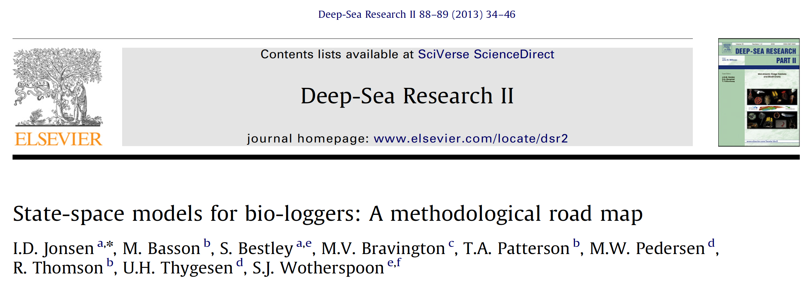
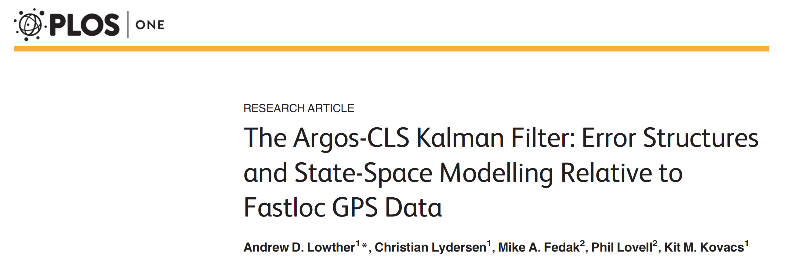
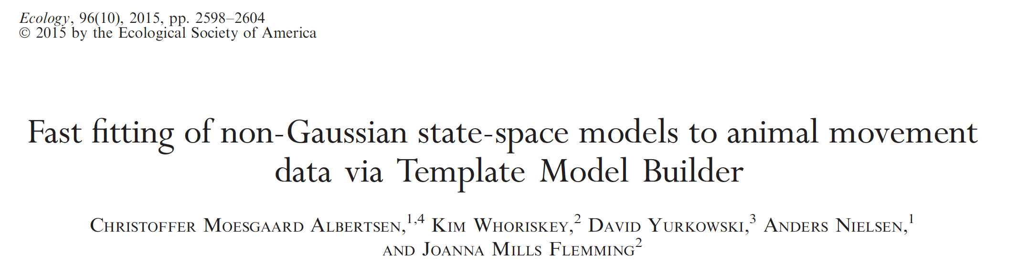
Notes:
State-space models are a very popular type of models for ecological time-series. They have been used to model fisheries catch data, animal movement, in epidemiology,economics, and in many other fields.

Slide 3
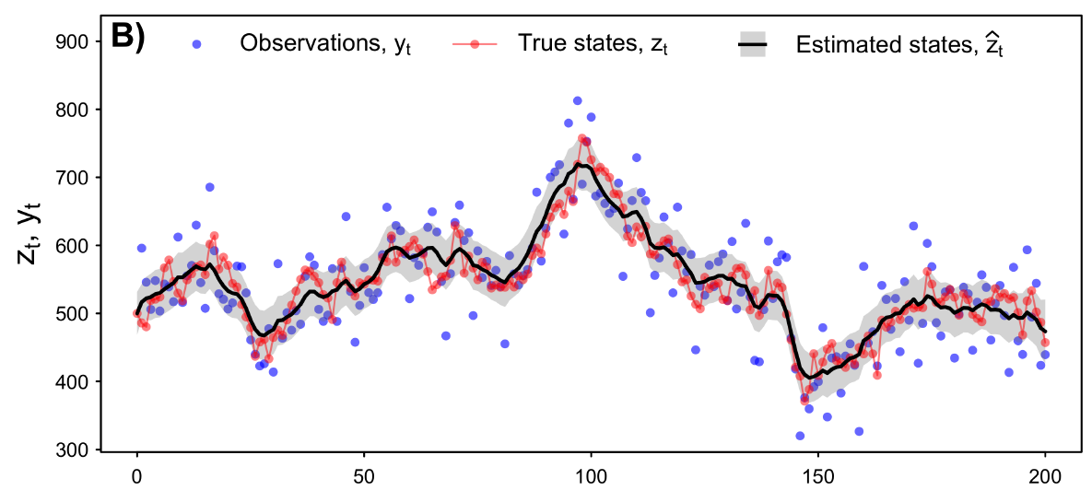
Better predict true values of a time series
Time
Auger-Méthé et al. (2021) Ecological Monographs
Notes:
State-space models have a variety of advantages, one them being that if the model is appropriate, they allow to predict the true values of time-series better than the raw observations do.
So here for example, we have the true (simulated) time series in red, we have the observation in blue, and the black line is the estimated values of the time series by a state-space model, and we can see that the estimated values are closer to the true values than the observed, and that the 95% confidence interval in grey, tend to include the true values. So they are doing a better job than the observations.

Slide 4
What are state-space models?
Notes:
Ok, but what are state-space models?

Slide 5
State-space model
Process equation:
x_{t} = f(x_{t-1}) + η_{t}
Measurement equation:
y_{t} = g(x_{t}) + ε_{t}
Notes:
They come in a variety of shapes and forms, but one important characteristic is that it’s a hierarchical model with at least two equations that are linked.
The process equation, which describes the process you are modelling, so for example the true size of a population.
And the measurement equation, which describes how the observations are gathered, so for example that accounts for biases associated with the survey design used.

Slide 6
State-space model
Process equation:
x_{t} = f(x_{t-1}) + η_{t}
State
Behavioural
mechanism
Process
noise
Measurement equation:
y_{t} = g(x_{t}) + ε_{t}
Notes:
The process equation models the state at time t, so for example where the animal is at time t.
And often the equation can be split into two parts. First we have a deterministic function f(x_{t-1}), which is often describes the behaviour we are studying. The function importantly incorporates the autocorrelation of our time series, so x_t is a function of the previous state x_{t-1}.
The second part is the process stochasticity or process noise eta_t. And that takes into account the fact that it’s almost impossible to describe the behaviour of an ecological process perfectly. There is pretty much always something we can’t explain or predict exactly.

Slide 7
State-space model
Process equation:
x_{t} = f(x_{t-1}) + η_{t}
State
Behavioural
mechanism
Process
noise
Measurement equation:
y_{t} = g(x_{t}) + ε_{t}
Data
Observation
mechanism
Measurement
error
Notes:
Our measurement equation models the observation at time t, y_t, and it’s also often split into two parts.
The first part is a deterministic function that describes the observation mechanism and is a function of the true state at time t, for example would account for any kind of systematic bias in your observation.
The second part, epsilon t, is the stochastic part that accounts for the measurement error.
And I haven’t written the parts that describes the process noise and measurement error, but for now, you can think of them as being normally distributed. We will see later that we are not restricted to Gaussian distributions.

Slide 8
State-space model
Process equation:
x_{t} = f(x_{t-1}) + η_{t}
x_{t-1}
x_{t}
x_{t+1}
State
Behavioural
mechanism
Process
noise
Measurement equation:
y_{t-1}
y_{t}
y_{t+1}
y_{t} = g(x_{t}) + ε_{t}
Data
Observation
mechanism
Measurement
error
Notes:
We can visualize this model, where the arrows represent the relationships we are modelling.

Slide 9
State-space model
Process equation:
x_{t} = f(x_{t-1}) + η_{t}
Temporal autocorrelation
x_{t-1}
x_{t}
x_{t+1}
State
Behavioural
mechanism
Process
noise
Measurement equation:
y_{t-1}
y_{t}
y_{t+1}
y_{t} = g(x_{t}) + ε_{t}
Data
Observation
mechanism
Measurement
error
Notes:
So the process equation models the autocorrelation, usually with a Markov chain, which just means that your state at time t only depends on the previous state.
And then the measurement equation models what you expect to see given the true state, so the pink arrows. And the graph shows that we assume the observations are conditionally independent.
The key here is that autocorrelation and model structure allows the model to differentiate between the process noise and measurement error, and thereby it allows us to estimate (predict) the states, so to get better prediction of the hidden process.

Slide 10
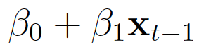
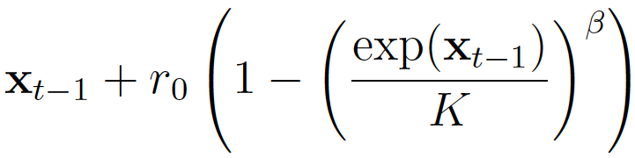
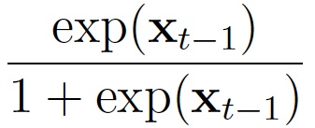
State-space model
Process equation:
x_{t} = f(x_{t-1}) + η_{t}
State
Behavioural
mechanism
Process
noise
Measurement equation:
y_{t} = g(x_{t}) + ε_{t}
Data
Observation
mechanism
Measurement
error
Notes:
One of the main advantages of state-space models, is that they are incredibly flexible. The deterministic parts can have a variety of forms

Slide 11
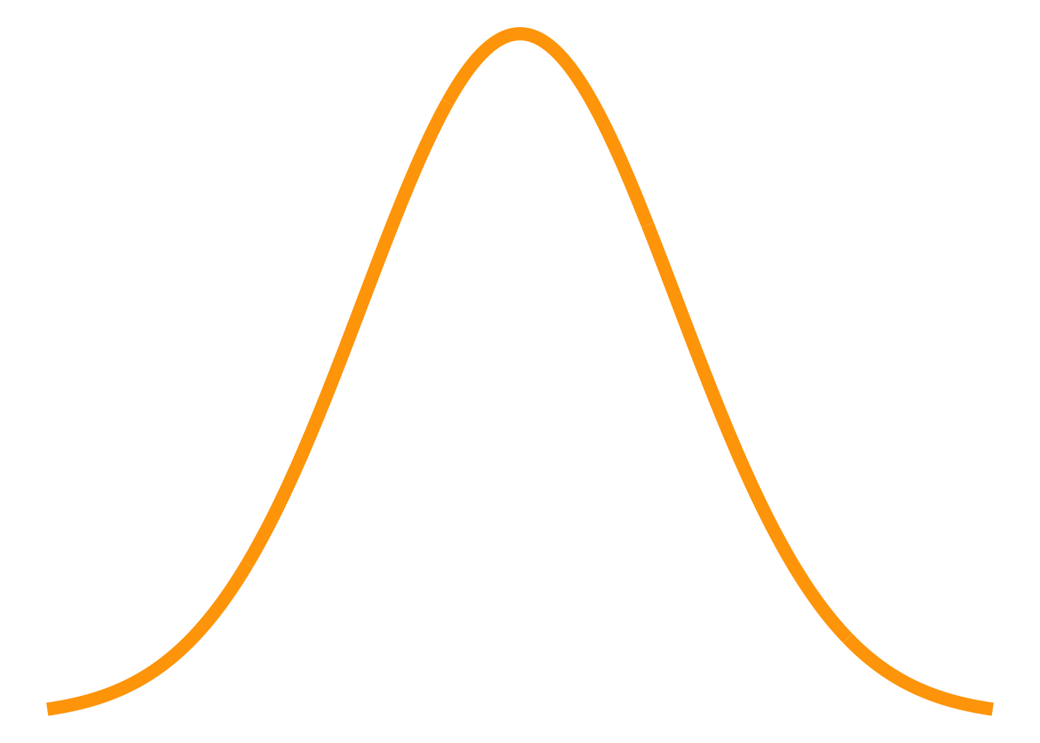
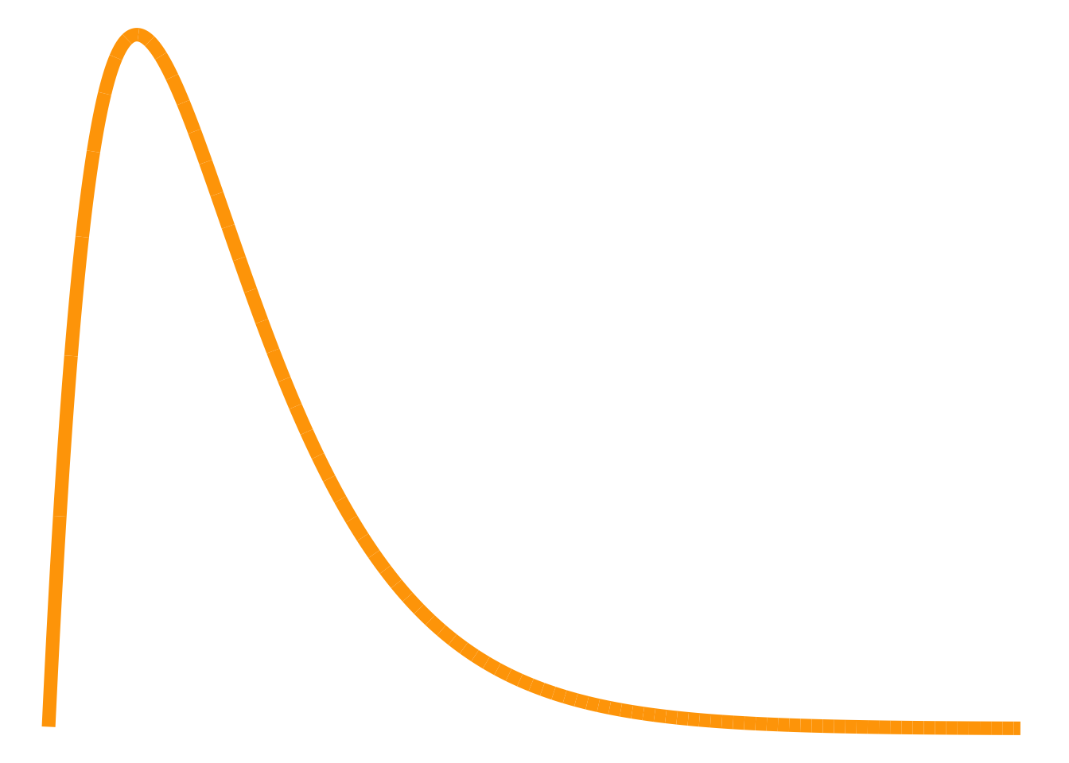
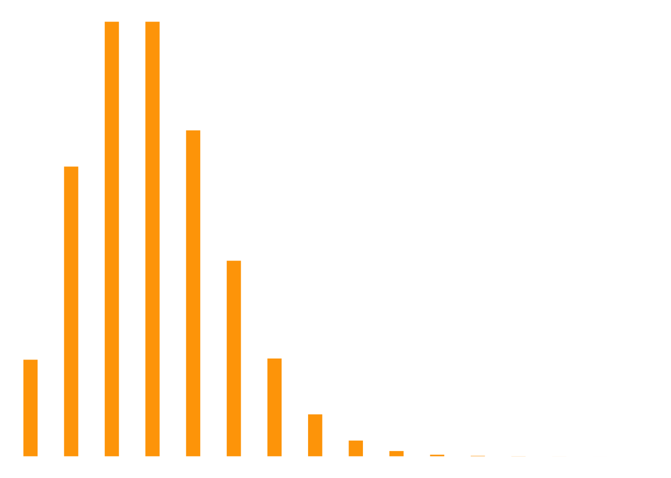
State-space model
Process equation:
x_{t} = f(x_{t-1}) + η_{t}
State
Behavioural
mechanism
Process
noise
Measurement equation:
y_{t} = g(x_{t}) + ε_{t}
Data
Observation
mechanism
Measurement
error
Notes:
and we can use a broad range of distributions for both the process noise and measurement error.

Slide 12
State-space model
Process equation:
x_{t} = f(x_{t-1}) + η_{t}
State
Behavioural
mechanism
Process
noise
Measurement equation:
y_{t} = g(x_{t}) + ε_{t}
Data
Observation
mechanism
Measurement
error
Notes:
And the stochatistic components do not need to be additive than can be integrated in various ways with the behavioural and observation mechanisms. I just write them in an additive form to make the point that there is stochasticity at both levels.

Slide 13
A toy example
Notes:
SO let’s look at a toy example, just to gell the ideas.

Slide 14
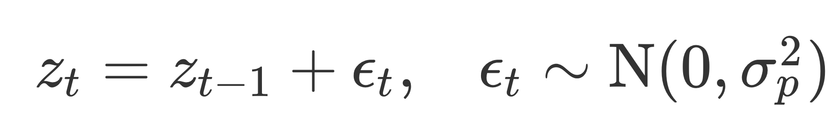
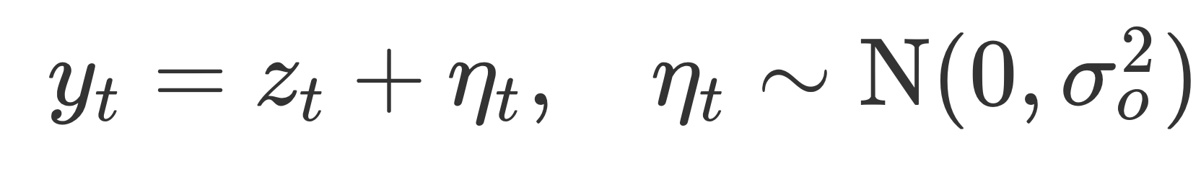
Toy example: Linear Gaussian state-space model
Process equation:
Measurement equation:
t
Notes:
So our toy example, is a linear Gaussian state-space model. It’s the textbook example that been used for decades.
Here the process equation just says that your state at time t is your state a time t-1 (so include that autocorrelation) + plus some noise, and process noise is normally distribution with mean 0.
The red line on the right was simulated using this equation.
Similarly, the measurement equation, simpy says the the observation is the true state at time t plu some Normal error. And this what generated the blue points on the right.

Slide 15
How do we fit these models to data?

Slide 16
Frequentist
Bayesian
Notes:
So first of all, we can fit these in a frequentist and Baysian framework. And I think some people are under the impression that complex state-space models can only be fitted with a Bayesian framework, but that’s not true, there are ways to fit them in a frequentist framework, and really the choice between whether you want to use a frequentist or a Bayesian approach in a philosophical choice, and sometime just implementation choice.
Both have value, but to present some of the basic concepts, I’ll use the frequentist framework.

Slide 17
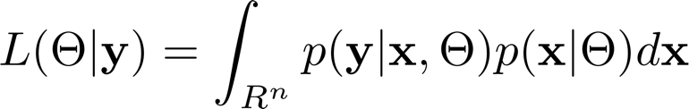
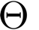
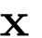
SSMs can be hard to fit
Marginal likelihood of SSM:
parameters:
unobserved true locations:
Notes:
But now how do we estimate the parameters.
So here we have the general equation for the likelihood function of a state-space model. Soit simply quantifies the likelihood that the available data would be observed if the model is true.

Slide 18
SSMs can be hard to fit
Marginal likelihood of SSM:
parameters:
unobserved true locations:
Measurement equation:
y_{t} = g(x_{t}) + ε_{t}
Data
Observation
mechanism
Measurement
error
Notes:
And here, the first part, describe the probability of the observed data given the state and the parameters, so it’s based on the measurement equation
and

Slide 19
SSMs can be hard to fit
Marginal likelihood of SSM:
parameters:
unobserved true locations:
Measurement equation:
Process equation:
y_{t} = g(x_{t}) + ε_{t}
x_{t} = f(x_{t-1}) + η_{t}
Data
Observation
mechanism
Measurement
error
State
Behavioural
or population
mechanism
Process
noise
Notes:
The second part describes the probability of the state given the parameters
And, one way to estimate the parameters in a frequentist framework

Slide 20
SSMs can be hard to fit
Marginal likelihood of SSM:
parameters:
unobserved true locations:
Measurement equation:
Process equation:
y_{t} = g(x_{t}) + ε_{t}
x_{t} = f(x_{t-1}) + η_{t}
Data
Observation
mechanism
Measurement
error
State
Behavioural
or population
mechanism
Process
noise
Notes:
The issue with state-space models, is that the likelihood involves a high-dimensional integration.
This integration accounts for all of the possible states (so for example all possible locations of the animal)
And high-dimensional integrations are generally unpleasant to handle.
Marginal likelihood

Slide 21

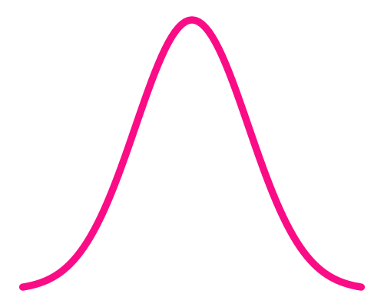

SSMs can be hard to fit
Marginal likelihood of SSM:
parameters:
unobserved true locations:
Analytical solution
Approximation
Kalman filter
y
Simulation
Laplace
Time
Flexible
Fast + semi flexible
Fast + exact
Slow
Semi flexible
Only for simple models
Auger-Méthé et al. (2021) Ecological Monographs
Notes:
The general idea is that if the marginal likelihood (Eq. 44) is a well-behaved unimodal function, it can be approximated with a Normal density function.

Slide 22
Ecological examples: animal movement models
Notes:
Ok, but now let’s turn to more interesting examples, and in particular, we will look at a few examples from movement ecology.

Slide 23

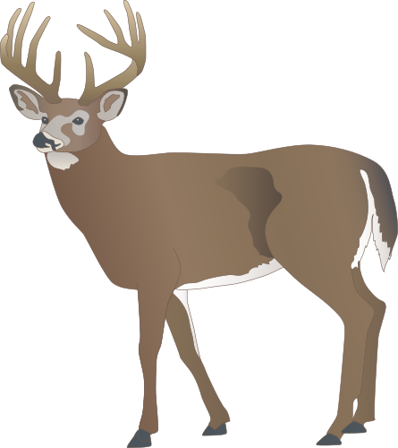



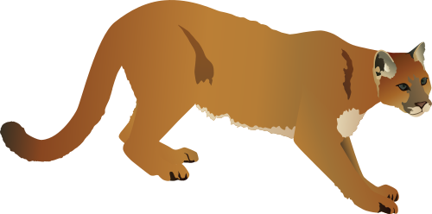

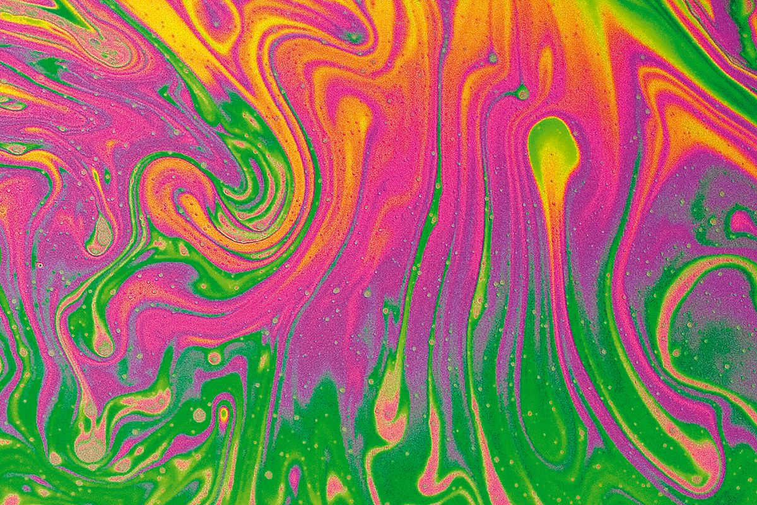
State-space models for movement: a history
Kalman filter to estimate location of spacecraft to the moon
First application in movement ecology
Models for marine animals
Complex behavioural models
1960
1991
2000
2013
…
Kalman
Brillinger
Avgar et al
Sibert & Fournier
Hooten et al
Jonsen et al
Eisaguirre et al
Jonsen et al
Anderson-Sprecher & Ledolter
Notes:
State-space models have a long history in movement analysis.
The very first development of a state-space model was actually to be able to recreate an accurate movement path of a space shuttle going to the moon, using noisy on board measurements of where the space shuttle was. What is now known as the famous Kalman filter, was used for all of the Apollo missions, and it’s quite commonly used in other navigation systems.
The application in movement ecology was 30 years later, and the goals were quite similar. Anderson-Sprecher showed that you could recreate a more accurate track on a mule-deer followed with VHF using the Kalman filter. And this was quite novel and important. But as GPS collars and tags became available around the same time, the need to use complex models to recreate tracks on land, became less necessary,
So it’s only 10 years later, that state-space models for movement ecology really started to blossom and that’s largely because marine animals could not be tracked with GPS tags, and the technology available at time (and to some extent still) has really large measurement error.
The next jump in state-space mode for movement ecology was to use these to not only infer better tracks but to infer hidden and complex behavioural and physiological processes. So for example, to get at how animal memorize their environment.

Slide 24
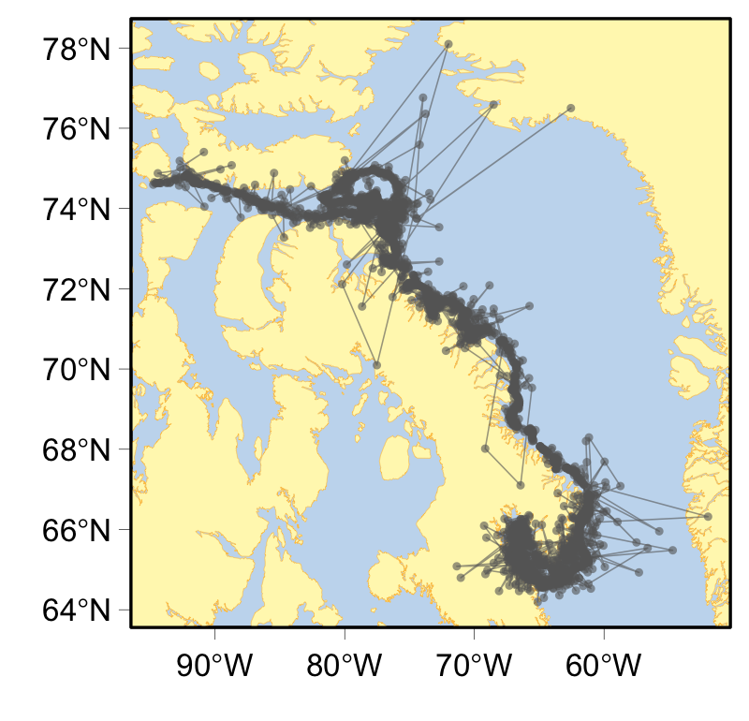
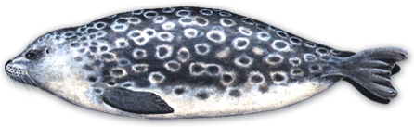
Marine movement data are/were error prone
Ringed seal
Argos locations
Notes:
So we will start with an example of the classic problem of dealing with measurement error.
So GPS doesn’t work underwater, and even for species that breathe at the surface, classic GPS technology doesn’t work well, because it requires too much time acquire the satellite data needed to estimate a location. Nowadays there is Fastloc GPS technology that's more accurate, but for a long time the main technology available for species like seals was Argos.
This is the track of a ringed seal equipped with an Argos tag. It’s moving along the coast of Baffin Island in Canada, but then, according to the data, once in a while it’s crossing to Greenland in a few hours. Which is very unlikely, and is actually just a measurement error. For marine animals most of the Argos locations have errors ranging from 5−35 km, and sometimes more.
And that why state-space models were developed to model the movement of marine animals.

Slide 25
State-space models to infer better tracks
Process:
t - 1
t
Measurement:
True movement
Observations (e.g., Argos data)
Estimated true locations
Notes:
So the basic idea behind using state-space models to infer better tracks is based on the fact that we can we can often create a simple-ish model that can give you a sense of where the animal is more probable to be at time t given where they were at time t-1. Here represented by the dark shade of blue. The general idea of many of the original models is that animals tend to continue in the same direction and at the same speed as they were before.
The model also describes where the observation will be, given where the animal actually is.
The pink circle here says that we are most likely to have an observation close to where the animal actually is, but there is a range of area where observations are still probably.
And here this observation falls within that range.
So the state-space model uses the data, and these simple probabilistic models to infer a better track.

Slide 26
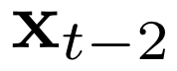
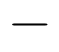
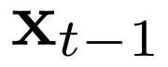
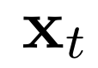
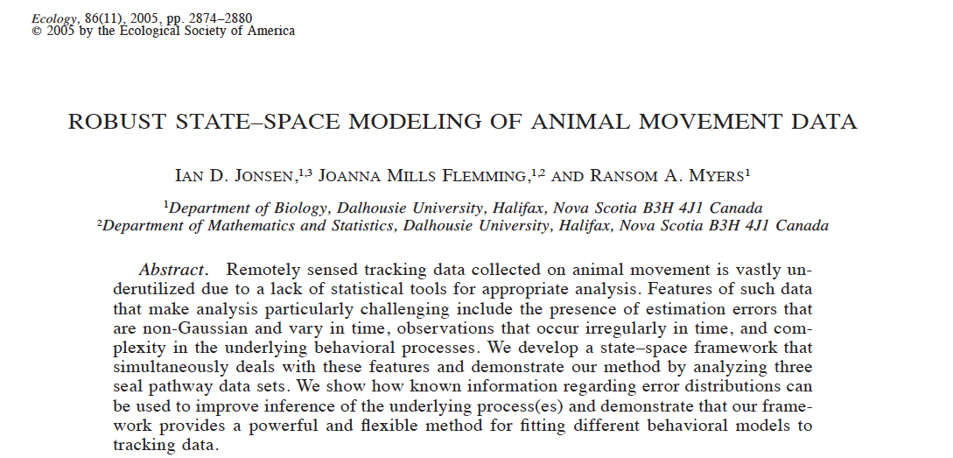
First difference correlated random walk
Process equation:
Notes:
Here a simplified version of one of the very first movement state-space models that was developed by Ian Jonsen and co-authors for Argos data.
Ok, so the process equation, says that the location at time t depends on the location at time t-1, but also depends on the movement that was done between time t-1 and t-2. The idea, is that if the correlation parameter gamma is close to 1, then the animal is expected to move in the same direction and at the same speed than at the previous time steps, shown with the grey arrow.
And then there is some noise. That allows for x_t to be not exactly where you would expect based on the previous movement. And here is the noixe is a bivatiate normal and that’s what the blue circle represent.

Slide 27
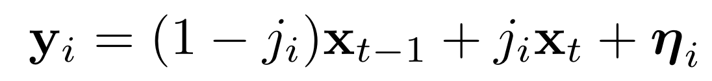
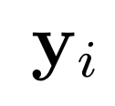
First difference correlated random walk
Process equation:
Measurement equation:
Notes:
Now the measurement equation address the peculiarities of the data. So Argos data is collected at irregular time steps, and that irregular time is index by i. In contrast, the process equation models the true location at regular time step t, and assumes that the animal moves in a straight line between the time steps t. So we assume that when we get an observation, the animal is on that line. To link the observation with the true location, we identify where on that line the animal would be based on the time of the observation relative to the regular time steps.
And the we put some error around it. Which is the pink circle. In the real model, we use a set of different distributions because Argos data has different location quality, but that’s kind of details here.
There are a lot of movement state-space models based on this idea, includingvsome in continuous time, some including different behaviours.
But question I always had is how good are these models? And the issue is that state-space models is that they are rarely validated with real data, because we rarely know where the animal truly is, that’s why we use them in the first place, right?

Slide 28
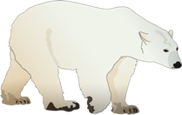
First difference correlated random walk
Process equation:
Measurement equation:
Argos
Large measurement error
GPS
Very accurate
Notes:
So I took advantage of the fact that our polar bear data had Argos and GPS locations for the same animals. So I could fit the model using the argos data and get estimates of the true locatiosn, and then I could compare these estimates to GPS locations, and see how good the model is.

Slide 29
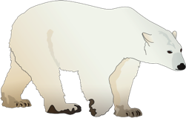
Estimates accurate locations from messy data
Argos locations
Estimated true locations
Auger-Méthé et al. (2017) Marine Ecology Progress Series
Notes:
Just to give you an example, we see here in grey the observed movement of a polar bear with ARGOS. And you can see that the grey points are all over the place. In red, is the estimated states from a movement state-space model, so the estimated true locations of the bear.

Slide 30
Estimates accurate locations from messy data
Argos locations
Estimated true locations
GPS locations
Auger-Méthé et al. (2017) Marine Ecology Progress Series
Notes:
And the black circles are GPS locations. We can see that the methods developed are pretty good at estimating the true locations, i.e. the estimated locations overlap with the GPS locations.
So when you use an appropriate SSM for your data, you can get pretty accurate estimates of the state. Though I will say that in this case one of the good properties of the data, is that we have lots of repeated locations in short time frame, which helped the model estimate the measurement error.

Slide 31
Joint models: modelling multiple data streams
Process eqn Describe the (shared) process of interest
x_{t-1}
x_{t}
x_{t+1}
Obs. Eqn 1
Obs. Eqn 2
y_{1,t-1}
y_{2,t-1}
y_{1,t}
y_{2,t}
y_{1,t+1}
Y_{2,t+1}
Data stream 1
Data stream 2
Notes:
Additional advantage of state-space model is that their structure makes it really easy to model multiple data streams, and what we might call a joint model.
Here we have our process equation again, and model the shared process of interest, and instead of having a single observation equation, we would have one observation equation per data stream.

Slide 32
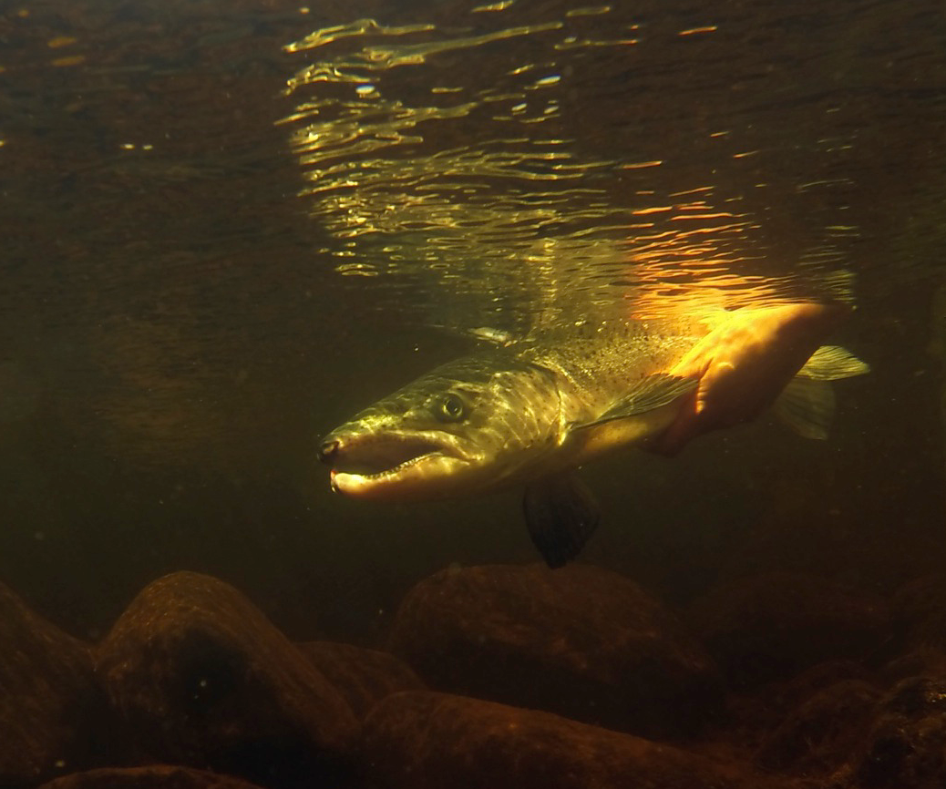

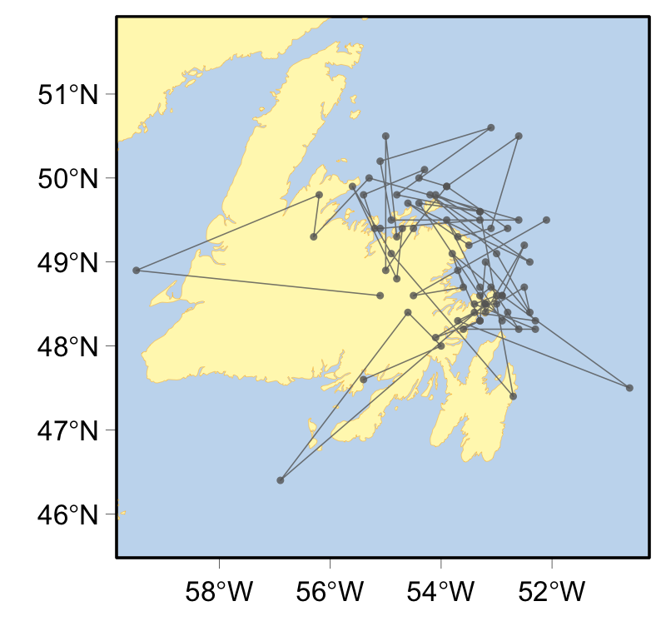
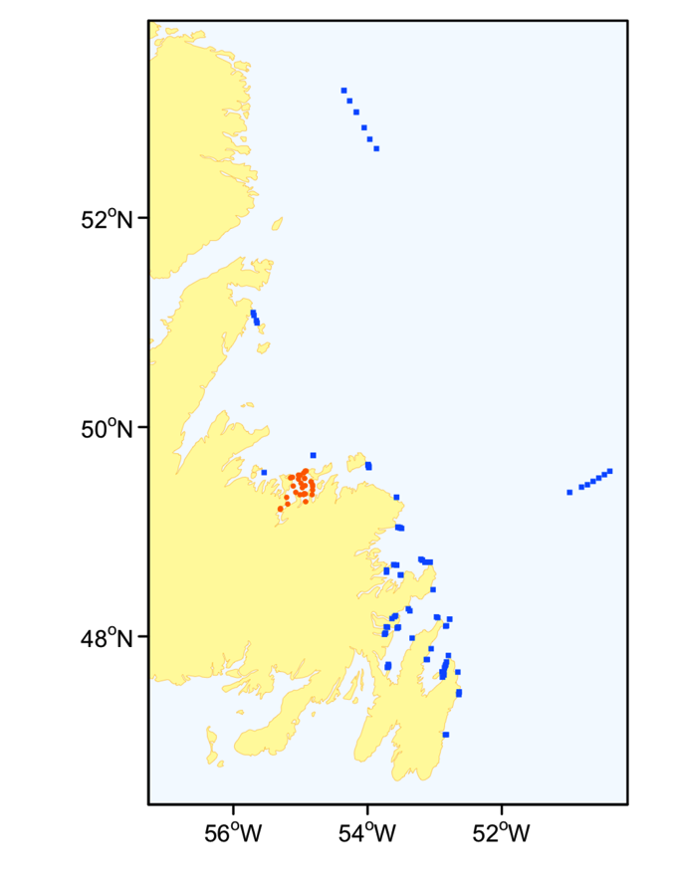
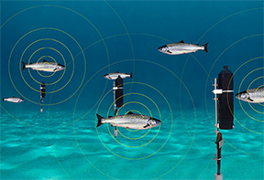
Multiple tags: GLS + acoustic tags Atlantic salmon
Kristin Bøe
Dr. Kristin Bøe
Acoustic tags + receivers
Light based geolocation (GLS)
Notes:
So here is an example using Atlantic salmon data collected by Kristin Boe, a while back now. On the left we have an animal movement track, here with Light based geolocation data, which is even more messy than Argos data, so has errors in the order of 100s km. And acoustic detection data. This is very different data. The tag is placed the fish that emit individually-distinct sound, which is recorded when they come in proximity of receivers (it's detection data). The colour dots on the map represent the locations of the receivers.

Slide 33
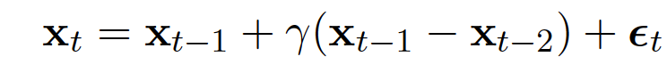
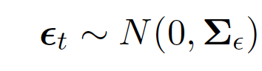
Joint state-space model
Process eqn Movement
Notes:
Our process equation is identical to the one I have just presented.

Slide 34
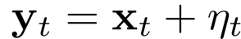
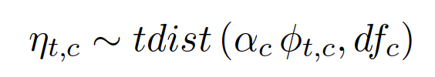
Joint state-space model
Process eqn Movement
Obs. eqn 1 Data stream: GLS
Notes:
And the observation equation for the light geolocation (GLS), is simply the true location, with some error which is distributed with a t-distribution, and is informed by a variable representingv the data quality at time t. And here unlike Argos data, the locations are at regular time intervals.

Slide 35
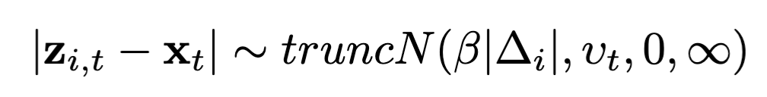
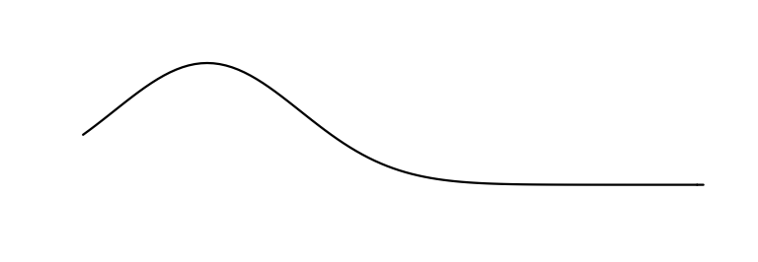

Joint state-space model
Process eqn Movement
Obs. eqn 1 Data stream: GLS
Obs. eqn 2 Data stream: acoustic detections
Distance from receiver to fish
Notes:
The observation equation for the acoustic detection is modelling the absolute distance between the receiver location z_t and the true location x_t with a truncated normal distribution with a mean being a function of the average speed of the animal, beta, and the time interval between the detection and the time of the true location delta_i. The idea is that the animal is going to be further from the receiver with time, you can of have a growing daugnout around the receiver..

Slide 36
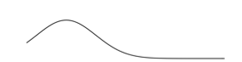

Simulations
Detections
Light geolocations
True locations of the animal
Predicted true locations of the animal
Notes:
We can see that the three models that include detections did better than the equivalent movement model without the detection data.

Slide 37




Atlantic salmon
Notes:
But where things really differ is in the embayment were there are lots of receivers. We can see that the models without detection information completely misses the fact that the animal stayed in that area for days.
So clearly including detection data helps the predicted track.
Gls time series ~70
Acoustics detections ~600, 2200.

Slide 38







Estimating mass gain with accelerometer data
© Douglas Noblet
Dr. Allison Patterson
Lighter murres flap less
© Douglas Noblet
Heavier murres flap more

Slide 39




Estimating mass gain with accelerometer data
© Douglas Noblet
Dr. Allison Patterson
Gain while diving (foraging)
$$z_{i,t}=z_{i,t−1}−β_{0}−β_{1}f_{i,t−1}+{(β}_{2}+β_{3}x_{1,i,t−1}+β_{4}x_{2,i,t−1})d_{i,t−1}+η_{i,t}$$
Basal loss
Extra loss while flying
$$η_{i,t}∼N\left(0,σ_{p}^{2}\right)$$
Max depth
Pitch SD

Slide 40


Estimating mass gain with accelerometer data
© Douglas Noblet
Dr. Allison Patterson
Gain while diving (foraging)
$$z_{i,t}=z_{i,t−1}−β_{0}−β_{1}f_{i,t−1}+{(β}_{2}+β_{3}x_{1,i,t−1}+β_{4}x_{2,i,t−1})d_{i,t−1}+η_{i,t}$$
Basal loss
Extra loss while flying
$$η_{i,t}∼N\left(0,σ_{p}^{2}\right)$$
$$y_{i,t}∼\text{N}\left(a_{i}\sqrt{z_{i,t}} , σ_{o}^{2}\right)$$
$$a_{i}∼N\left(α,σ_{α}^{2}\right)$$

Slide 41



Estimating mass gain with accelerometer data
© Douglas Noblet
Dr. Allison Patterson
Change in mass (g)
Gain rate (g/h) while diving
58
Change in mass (g)
Depth (m)
30
t
Notes:
If I have time change colors!!

Slide 42
Modelling behaviours with hidden Markov models
Notes:
Ok, but now let’s turn to more interesting examples, and in particular, we will look at a few examples from movement ecology.

Slide 43


Hidden Markov models for discrete states
Travelling
Foraging
x_{t-1}
x_{t}
x_{t+1}
y_{t-1}
y_{t}
y_{t+1}

Slide 44
Hidden Markov model
ARS
Notes:
Let me concretise this concept with a hidden Markov model, a model that many movement ecologists have ikely encountered in the literature.

Slide 45
Hidden Markov model
ARS
Travel
Notes:
Let me concretise this concept with a hidden Markov model, a model that many movement ecologists have ikely encountered in the literature.

Slide 46
Hidden Markov model
1-γ₁₁
Process eqn Switch in behaviour
ARS
Travel
γ₁₁
γ₂₂
1-γ₂₂
Notes:
One key aspect of the area-restricted search is that the animal will do multiple steps of this tortuous movement, so it can stay within a food patch. To represent this behavioural persistence, the model has parameters that describe the probability of remaining in a behaviour, and the probability of switching. An this autocorellation, is really a key part of these hidden markov models,
When we proposed this method, now seven years ago), HMMs were not often used with animal movement data and there where many competing foraging stategy models, and so one of the things we were interested in was identifying whether this model was a good competitor to simpler alternatives.

Slide 47
Measures of movement: 2 data streams
Locations
Turning angle
Step length

Slide 48


Hidden Markov model
Step length
Turning angle
ARS: high probability of small steps
ARS: high probability to turn in all directions
Probability
Notes:
For the step length distribution of both behaviours, I used an exponential distribution. Although I use the same distribution for both, the two behaviours can differ in their parameter values. In particular, the mean step length within a food patch, is expected to be smaller than the mean step length between food patches. And we can see this by the higher probability of small step lengths under the the pink line than in the blue line.
One thing to keep in mind, is that I set the distributions used, but we are using the data to estimate the parameters of the distribution (so here we estimate the mean step length of each behaviour).
Change distributions and colours.

Slide 49


Hidden Markov model
Step length
Turning angle
ARS: high probability of small steps
ARS: high probability to turn in all directions
Travel: high probability of larger steps
Travel: high probability to remain in the same direction
Probability
Notes:
For the step length distribution of both behaviours, I used an exponential distribution. Although I use the same distribution for both, the two behaviours can differ in their parameter values. In particular, the mean step length within a food patch, is expected to be smaller than the mean step length between food patches. And we can see this by the higher probability of small step lengths under the the pink line than in the blue line.
One thing to keep in mind, is that I set the distributions used, but we are using the data to estimate the parameters of the distribution (so here we estimate the mean step length of each behaviour).
Change distributions and colours.

Slide 50





HMMs are easy to fit simple likelihood
$$vector of initial state probabilities$$
$$ℒ=δP\left(y_{1}\right)ΓP\left(y_{2}\right)…ΓP\left(y_{T}\right)1^{′}$$
$$P(yt)=\left[\begin{matrix}p_{1}(yt) & … & 0 \\ … & ⋱ & … \\ 0 & … & p_{m}(yt)\end{matrix}\right]$$
$$Γ=\left[\begin{matrix}γ_{1,1} & ⋯ & γ_{1,m} \\ ⋮ & ⋱ & ⋮ \\ γ_{m,1} & ⋯ & γ_{m,m}\end{matrix}\right]$$
$m$: # of states
${ p}_{i}\left(yt\right)$ = $Pr\left(Y_{t}=yt∣S_{t}=i\right)$
1-γ_{1,1}
ARS
Travel
γ_{1,1}
γ_{2,2}
1-γ_{2,2}

Slide 51




Olfactory search
Dr. Ron Togunov
Togunov et al. (2021) Methods in Ecology & Evolution
Notes:
The other aspect that is important for polar bears, is that they rely on the sense smell. And so the best searching strategy is associated with wind. In particular, it may be advantageous to walk perpendicular to the wind, until you hit an odour plume. And then you may walk up wind.
#####################
It’s especially difficult to find ringed seal pupping lairs, which are buried under several meters of snow and are impossible to see.
Polar bears can smell seals from more than 1 km away and up to 1 metre under the snow.
But how should polar bears search their environment if they don’t smell anything at all?
It turns out, polar bears use the same strategies as moths and fruit flies; travel cross-wind! By travelling crosswind, bears are constantly passing through new streams of air, learning about everything up-wind of them, and maximize their chances of crossing an odour plume.
After a bear smells something it is interested in, they turn and travel up-wind and to find the source.

Slide 52
Measures of movement
Locations
Angle in relation to wind
Turning angle
Step length
Notes:
To do, we need two measures of movement
Step length, which is the distance between to locations.
And the relative turning angle, which measures how much the animal deviates from its previous direction.

Slide 53


HMMs for complex behaviours
Dr. Ron Togunov
Turning angle if moving downwind
Olfactory search
Drifting (bear stationary)
Area-restricted search
Togunov et al. (2021) Methods in Ecology & Evolution
Notes:
Ron developed a Hidden Markov model that allow to detect movement associated with wind. In particular, he modelled olfactory search, which depending on the direction of the wind may results in the bear walking 90 degree to the right or left of the wind. Drifting meaning the bear is stationary, which is in truth associated with sea ice, but can be better modeled here with wind, and because of the corriolis effect is predicted to be a 15 to the left of wind direction. And area-restricted search, which should not be associated with wind, and could still represent a bear searching for food when it can no longer rely on smell, or when having another behaviour.
It’s quite complex model, but the basic idea is that there an additional measure of movement which is the turning angle in relation to wind and previous movement, so allowing for both behavioural persistence and reaction to the wind. And what we see here is the estimated turning angle if the bear is moving downwind at the previous time step. And we see what we expected. For olfactory search in red and orange, we see that the animal will have a tendency to move 90 in either direction. For drift, it’s a bit more complicated because there is a discrepancy between temporal scale of the wind data and the bear data. Because the wind tends to stay in same direction for hours, dirft movement appears really autocorrelated, and that’s why we see that peak at 0 in light blue.
If we look at the predicted behaviours on a subset of the movement path, we see clear patterns. Bear doing olfactory search followed by a long stretch drifting, which could be waiting for the prey to come out or eating the prey or sleeping.
This was a methodological paper, and now Ron is applying the model to a large polar bear data set to try to identity the environmental covariates that are associated with each behaviour.

Slide 54


Shift in behaviour
Dr. Ron Togunov
Togunov et al. (2022) Movement Ecology
Notes:
High energy behaviors occurred later in the day (around 20:00) compared to other
populations. Second, olfactory search increased as the season progressed, which may reflect a shift in foraging strategy
from still-hunting to active search linked to a shift in seal availability (i.e., increase in haul-outs from winter to the
spring pupping and molting seasons).
For a transition probability matrix Γ, the stationary distribution is the vector δ that solves the equation
δ = δΓ, subject to ∑N
i=1 δi = 1 (see Section 4.1.4 for more information). It reflects the long-term proportion
of time the model spends in each state.
When the transition probabilities are time-varying (i.e. functions of covariates), the stationary distribution
does not exist. However, for fixed values of the covariates, we can obtain one transition probability matrix,
and thus one stationary distribution. The function plotStationary does this over a grid of values of each
14
covariate, and plots the resulting stationary state probabilites. They can be interpreted as the long-term
probabilities of being in each state at different values of the covariate.

Slide 55


Why are southern resident killer whales doing poorly?
Evan Sidrow PhD student
Southern residents
~75
Decreasing?
Poor body condition
Northern residents
~300
Increasing
Better body condition
Harder to capture fish? Spending more energy?
HMM
Notes:
As part of a big research collarboative project we are trying to understand why the southern resident killers whales are doing more poorly than thei neighbour the northern reseident killers.
[Info on population]
Some of the questions we are interested in answering is whether it’s harder for the souther resident to catch prey and whether they are spending more energy doing so. An to be able to do this, my PhD student Evan Sidrow, has been developing advanced HMMs.
####### Notes
Evan Sidrow, another PhD student in my group is developing Hidden Markov models to help a very big, collaborative, project on southern resident killer whales.
Sourthern resident killers are endangered. They have a really small population of about 75 individuals. The population may be declining, or at not increasing, and they appear to be have poor body condition.
Goal of this project is to try to understand why they are doing so poorly, when their neighours which eat same prey (the chinook salmon), are doing much better.
The northern residents have a higher population size, there are sign sthat the population is increasing, and it appears that they are in better condition.
So the questions are is there less food available to the southern residents, or are they harder to capture, maybe the chinook are at deeper depths, maybe the southern resident need to spedn more energy to get at catch a prey.
So we have fine-scale movement and diving data from both populations. Evan is developing hidden markov models that can help identify when the whales are chasing, or capturing a prey, and when they are spending more energy so we compare the populations.

Slide 56

High frequency data
Evan Sidrow PhD student
© S. Fortune
Sidrow et al. (2021) Canadian Journal of Statistics
Notes:
But we had to modify the mode because of the data used. So we are modding diving data (depth of the animal through time). This is just a short bit for one whale. And acceleration on three axis. Just like a fitbit, we get movement up-down, movement side-ways, and movent forward-backward.
And really the key differencd statistically is that it’s extremely high frequency data. The polar data was ranging from 30 min to 4 hours, here were taking 50 HZ, so 50 datapoints er second.
50 Hz

Slide 57










HMM for high frequency data
Evan Sidrow PhD student
Observations
(e.g., max depth)
$$Y_{1}$$
…
$$Y_{t−1}$$
$$Y_{t}$$
$$Y_{t+1}$$
…
$$Y_{T}$$
Hidden states
(e.g., foraging vs travelling)
$$X_{1}$$
…
$$X_{t−1}$$
$$X_{t}$$
$$X_{t+1}$$
…
$$X_{T}$$
Sidrow et al. (2021) Canadian Journal of Statistics
Notes:
There many ways to tackle this, but one we think is particularly useful is using the hidden Markov model framework. Hidden Markov models (HMM) are a type of hierarchical models specifically design to identify hidden states from time series data.
The idea is that you model 2 time series: one time series of observations and one of hidden states. The hidden state time series is assumed to be a Markov chain, where the where the state at time t only depends on the state at time t-1. And that make sense in most cases as whether a human or animal is running at time t is likely correlated to whether it was running at the previous time step. And the observation are conditionally independent of one another, and their dependence is on the state, but not on other observations.
The key here, they distribution is a function of the hidden you are in.
The key parameter to estimated are the switching probability and the parameters associated with the emission distribution.
#######
So one way to portray hidden markov models, is with this graph.
We have these hidden states, so here say whether the whale is foraging or resting. And these hidden beavhours affect the distribution of our observation (the distribution of our measures of movement). So remember the distribution I was shoing for the step and turning angle for the polar bear.
The key here is that we assumed the behaviours are autocorrelated in time, so if the whale was forging now, it’s more likely that it’s forgiang at next time step. And once you’ve accounted for that correlation, the observations are assumed to be independent of one another (no arrows between the ys).

Slide 58







HMM for high frequency data
Evan Sidrow PhD student
Observations
(e.g., max depth)
$$Y_{1}$$
…
$$Y_{t−1}$$
$$Y_{t}$$
$$Y_{t+1}$$
…
$$Y_{T}$$
Hidden states
(e.g., foraging vs travelling)
$$X_{1}$$
…
$$X_{t−1}$$
$$X_{t}$$
$$X_{t+1}$$
…
$$X_{T}$$
Coarse
Hidden states
(e.g, gliding vs swimming)
…
$$X_{t,t^{∗}−1}^{∗}$$
$$X_{t,t^{∗}}^{∗}$$
$$X_{t,t^{∗}+1}^{∗}$$
…
Fine
…
…
$${\tilde{Y}}_{t,t^{∗},1}^{∗}, …,{\tilde{Y}}_{t,t^{∗},100}^{∗}$$
…
…
Summary statistics
Observations
(e.g., acceleration)
…
$$Y_{t,t^{∗}−1}^{∗}$$
$$Y_{{t,t}^{∗}}^{∗}$$
$$Y_{t,t^{∗}+1}^{∗}$$
…
Sidrow et al. (2021) Canadian Journal of Statistics
Notes:
There many ways to tackle this, but one we think is particularly useful is using the hidden Markov model framework. Hidden Markov models (HMM) are a type of hierarchical models specifically design to identify hidden states from time series data.
The idea is that you model 2 time series: one time series of observations and one of hidden states. The hidden state time series is assumed to be a Markov chain, where the where the state at time t only depends on the state at time t-1. And that make sense in most cases as whether a human or animal is running at time t is likely correlated to whether it was running at the previous time step. And the observation are conditionally independent of one another, and their dependence is on the state, but not on other observations.
The key here, they distribution is a function of the hidden you are in.
The key parameter to estimated are the switching probability and the parameters associated with the emission distribution.
#######
So one way to portray hidden markov models, is with this graph.
We have these hidden states, so here say whether the whale is foraging or resting. And these hidden beavhours affect the distribution of our observation (the distribution of our measures of movement). So remember the distribution I was shoing for the step and turning angle for the polar bear.
The key here is that we assumed the behaviours are autocorrelated in time, so if the whale was forging now, it’s more likely that it’s forgiang at next time step. And once you’ve accounted for that correlation, the observations are assumed to be independent of one another (no arrows between the ys).

Slide 59




Diving behaviour of killer whales
Evan Sidrow PhD student
Behavioural budget
Energy budget
Sidrow et al. (2021) Canadian Journal of Statistics
Notes:
And Evan showed that you use this methodology to differentiate short and long dive. Short dive at the surfacem vs longer deeper dives. But more interesting, with the fine-scale behaviours we can get at different levels of activity. We get these low activity level, where the whale is glidding, these medium activity levels where fluking regularly, that’s what we what we see here it’s the fluking pattern, and high activity movememt higher frequencymore variable.
One interesting aspect, which appear counter intuitive at first, is that it appears that in shorter dives whales are moving more (spending more energy per second) that in deeper dives. And in fact, that makes sense in that we know that whales try to conserved energy at depth.
So we are just starting here. Now we have validation data. So for certain animals we know when they were capturing a prey based acoustic and visual data. Based echolocation we know when they homing down on a prey. And Evan working now, is using that data to help identify the specifc movement characteristcs assocites with the beahviours of interests so we can provide the tools to answer whether the southern residents are less efficient at catching prey than northern residents.

Slide 60



Detecting successful prey captures
Evan Sidrow PhD student
Descent
Bottom
Chase
Capture
Ascent w/o fish
Ascent w fish
Labels
Labels

Slide 61

Detecting successful prey captures
Evan Sidrow PhD student
Descent
Bottom
Chase
Capture
Ascent w/o fish
Ascent w fish
Labels
Labels

Slide 62

Southern residents less efficient?
Evan Sidrow PhD student
Southern resident: 1.03 fish/foraging hour
Northern residents: 2.00 fish/ foraging hour
!
Small sample size

Slide 63
Potential problems & solutions

Slide 64








Order selection under misspecification
Fanny Dupont PhD student
More?
Travelling
Foraging
Socializing
$\tilde{l}\left(ψ|Y\right)=$ $l\left(ψ|Y\right)$ + $C_{N}\sum_{j=1}^{N}{\log{π_{j}}−}$ $\sum_{j=1}^{N−1}{p_{λ}}$
Correctly chosen # of states (%)
Thursday S-6-2 (10:30-12:30) Talk ID: 158
Notes:
Jeudi, S-6-2

Slide 65



















Thank you!
A Derocher, K Newman, L Thomas, D Cole, V Leos-Barajas, R Gryba, A King, G Petris, A Nielsen, F Empacher, I Jonsen, G. Crossin, J. Mills Flemming, C Field, M Lewis, C Albertsen, D Lidgard, K Studholme, W. Bowen, K Boe, A Patterson, F Dupont, E Sidrow, R Togunov, N Lunn, A Trites, S Fortune, N Heckman, M Marcoux, N Hussey, Kyle Elliott

Slide 66

Questions?

Slide 67








Estimation problems
Process equation:
Parameters
Measurement equation:
True/simulated
Estimated
Auger-Méthé et al. 2016 Scientific Reports
Notes:
And what we can noticed is that the RMSE based on the estimated parameters are far worst than those based on the true parameter. What’s happening is that, because there is no measurement error, the states is just mirroring the observations which we know are inaccurate.
So we have to remember here that state-space models are used when the data has large measurement error. And from these results that’s the case when there are estimation problems.
And recently writing the review, I looked this more and realized that some of the problem is dependent on the first state value. X_0. SO if X_0 is quite far from 0 the problem is less pronouced.

Slide 68
Estimation problems
Process equation:
Parameters
Measurement equation:
True/simulated
Estimated
Auger-Méthé et al. 2016 Scientific Reports
Notes:
And what we can noticed is that the RMSE based on the estimated parameters are far worst than those based on the true parameter. What’s happening is that, because there is no measurement error, the states is just mirroring the observations which we know are inaccurate.
So we have to remember here that state-space models are used when the data has large measurement error. And from these results that’s the case when there are estimation problems.
And recently writing the review, I looked this more and realized that some of the problem is dependent on the first state value. X_0. SO if X_0 is quite far from 0 the problem is less pronouced.

Slide 69
Estimation problems
Process equation:
Parameters
Measurement equation:
True/simulated
Estimated
RMSE
Auger-Méthé et al. 2016 Scientific Reports
Notes:
And what we can noticed is that the RMSE based on the estimated parameters are far worst than those based on the true parameter. What’s happening is that, because there is no measurement error, the states is just mirroring the observations which we know are inaccurate.
So we have to remember here that state-space models are used when the data has large measurement error. And from these results that’s the case when there are estimation problems.
And recently writing the review, I looked this more and realized that some of the problem is dependent on the first state value. X_0. SO if X_0 is quite far from 0 the problem is less pronouced.

Slide 70

Identifiability
Notes:
Estimation problems are associated with identifiabilty problems. So the idea I sthat when you do maximum likelihood you trie to find the parameter value that has the peak lieklihod value (or log likelihood). You want a single nice rounded peak. That says that there is one paremater value that maximise the likelihood.

Slide 71
Identifiability
Notes:
But in some cases there are multiple peaks, in the like lihood profile, which means that the two different parameter values give you the same amximum likelihod, so them you are stuck, which one is the good one. And in truth a model that produce mltiple peaks is bad model for your data.

Slide 72
Identifiability
Notes:
And then some case, ou got falat lines, and that’s not that means that a wide range of parameter values give the same probabiliy. And the issues is that whaterver optimister you use is likely to output a single value, even if the likelihod is flat. So the thing to do is explore the plot likelihod rpofile.

Slide 73


Likelihood profile
Good model
Bad model
Notes:
So that’s the likelihod profiles for the parameters of our toy model. So the doted like is the like value the the straight vertical like is the estimated value retuned by the estimating procedure, the grey is the retuned confidence interval, and the dashed line is the true simulated value. So clearly here we have a proble. It’s flat in places, it has multeplie peaks, and so I would look this now, and say, change you model.

Slide 74

Posterior predictive measures
Fit model to data
Calculate measure
Good model
Simulate from fitted model
Simulate from fitted model
…
Calculate measure
…
Calculate measure
SD(y^{i})

Slide 75

Posterior predictive measures
Fit model to data
Calculate measure
Good model
Bad model
Simulate from fitted model
Simulate from fitted model
…
Calculate measure
…
Calculate measure
SD(y^{i})
SD(y^{i})

Slide 76


One-step-ahead residuals
Good model
Bad model

Slide 77


R tutorial! How to fit SSMs with TMB, stan, NIMBLE, +

Slide 78
One-step-ahead residuals
Good model
+ transformation that makes them normally distributed if from good model
Bad model

Slide 79
Estimating the states
Process eq.
x_{t} = f(x_{t-1}) + η_{t}
Time
y
Measurement eq.
y_{t} = g(x_{t}) + ε_{t}
Notes:
Let’s first assume that we know the parameters and we are just trying to estimate the states.
And here all explain the idea of how to estimate the state using a type particle filter (so a monte carlo method, if that means something to you), because I, personaly, find it kind of intuitive, but there are many other ways to do this.
Ok, so again we know the parameters. Here in lack we have our observations through times. This is is a toy example. Here the observation are more or less increasing in magnitude with time. And we assume for simplicity that the first observation is the true value, so the x at time 0. It doesn’t need to be like that but it’s just simpler to explain.
So the first thing a particle filter will do, is simulate values for the next time step using the process equation. Here we simulater 5 possible values for x at time 1
Then we use the measurement equation asses the probability of the data given each of the proposed x values, that gives us the likelihoof of each of the proposed x, and here the ones that are closer to the observation are more propoable. And here darker pink, means more probable Based on that probabiliy we select with replacement 5 states, so that means some will liekly be slected more than once.
And then we we use again the process equation to simulate where the x at time 2 would be.
We see hre that two original prpoposed values having been droped.
Then again we use the measurement equation to assess hpw likelid each proopsed values are if we take into account the observation at the time. And again, in the omdele x values closer to the pbservtion are more likely (so in darker pink).
COULD ADD 0, 1, 2 Could make slection of dots before process equation.

Slide 80
Hidden Markov Model
Evan Sidrow PhD student
Observations
(e.g., max depth)
$$Y_{1}$$
…
$$Y_{t−1}$$
$$Y_{t}$$
$$Y_{t+1}$$
…
$$Y_{T}$$
Hidden states
(e.g., foraging vs travelling)
$$X_{1}$$
…
$$X_{t−1}$$
$$X_{t}$$
$$X_{t+1}$$
…
$$X_{T}$$
Sidrow et al. (2021) Canadian Journal of Statistics
Notes:
There many ways to tackle this, but one we think is particularly useful is using the hidden Markov model framework. Hidden Markov models (HMM) are a type of hierarchical models specifically design to identify hidden states from time series data.
The idea is that you model 2 time series: one time series of observations and one of hidden states. The hidden state time series is assumed to be a Markov chain, where the where the state at time t only depends on the state at time t-1. And that make sense in most cases as whether a human or animal is running at time t is likely correlated to whether it was running at the previous time step. And the observation are conditionally independent of one another, and their dependence is on the state, but not on other observations.
The key here, they distribution is a function of the hidden you are in.
The key parameter to estimated are the switching probability and the parameters associated with the emission distribution.
#######
So one way to portray hidden markov models, is with this graph.
We have these hidden states, so here say whether the whale is foraging or resting. And these hidden beavhours affect the distribution of our observation (the distribution of our measures of movement). So remember the distribution I was shoing for the step and turning angle for the polar bear.
The key here is that we assumed the behaviours are autocorrelated in time, so if the whale was forging now, it’s more likely that it’s forgiang at next time step. And once you’ve accounted for that correlation, the observations are assumed to be independent of one another (no arrows between the ys).

Slide 81
Estimating the states
Process eq.
x_{t} = f(x_{t-1}) + η_{t}
Time
y
Measurement eq.
y_{t} = g(x_{t}) + ε_{t}
Notes:
Demonstrate the simulations

Slide 82
Estimating the states
Process eq.
x_{t} = f(x_{t-1}) + η_{t}
Time
y
Notes:
Demonstrate the simulations

Slide 83
Estimating the states
Process eq.
x_{t} = f(x_{t-1}) + η_{t}
Time
y
Measurement eq.
y_{t} = g(x_{t}) + ε_{t}
Notes:
And then we continue tis itterative process.

Slide 84
Estimating the states
Time
y
Notes:
Demonstrate the simulations

Slide 85
Estimating the states
Time
y
Notes:
And at the very end we can estimate the true state by taking the weight average of the values. So those value at a give time step that are more likely give the measurmenet equation, are weighted higher when taking the average.
This is a completely artificial examplem but red line here represent what could that estimate track. Based on the simlutae and weighted values.

Slide 86
TMB & the Laplace approximation
Marginal likelihood of SSM:
parameters:
unobserved true locations:
Laplace approximation
If the marginal likelihood is a well-behaved unimodal function
It can be locally approximated by a Normal distribution
States are assumed to have a smooth distribution with one peak i.e. Cannot be categorical, bimodal, …
Bonus: this approximation requires the maximization of the joint likelihood with respect to the states
i.e. TMB estimates the parameters and states at the same time!

Slide 87

Detecting successful prey capture
Evan Sidrow PhD student

